Slide 1


Customer Segmentation and Credit-Risk Modelling
End-Eval presentation
Mentors:
Shivam Pandey
Nivin Vinod

Slide 2

CONTENTS:
Train-test split
Chi-Square Test of Independence
ANOVA (Analysis of Variance) and F-test
What is Binning of Data?
WOE (Weight of Evidence)
Information Value
Modelling Pipeline
Cross-Validation Criteria
Threshold Value
Confusion matrix
ROC CURVE
AUROC AND GINI COEFFICIENT
PR CURVE
Summary Table
concatenation of DataFrame
Credit score
Youden’s J Stastistics
Setting loan approval cutoffs

Slide 3
A QUICK RECAP BEFORE MID EVAL
KEY COMPONENTS:-
Data Cleaning
PCA(Principal component analysis)
K-Means Clustering

Slide 4

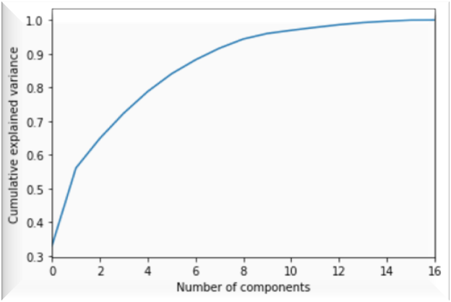
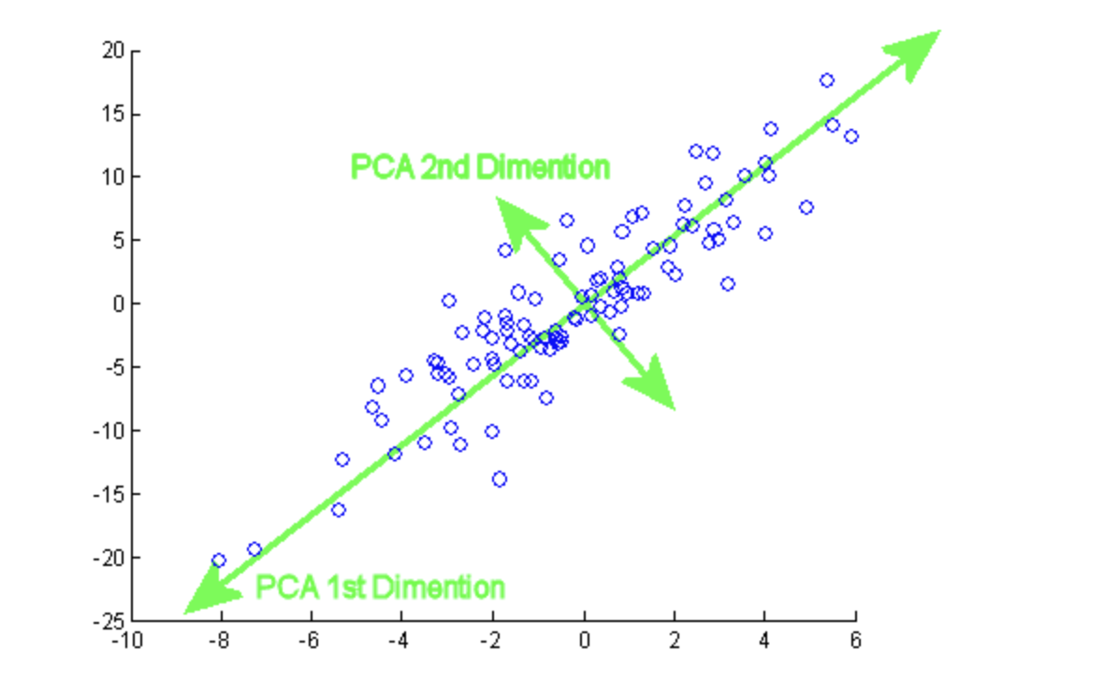
PCA-Principal Component Analysis
Statistical procedure that helps in reducing no. of columns in the data-sett to a few columns called principal components that still cover most of the data.

Slide 5
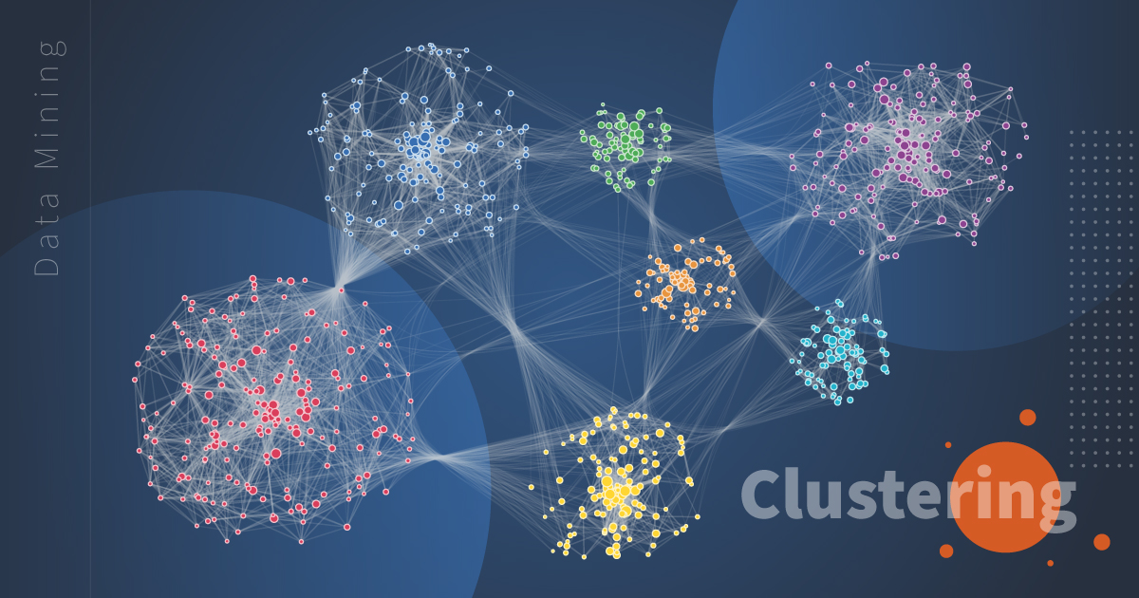
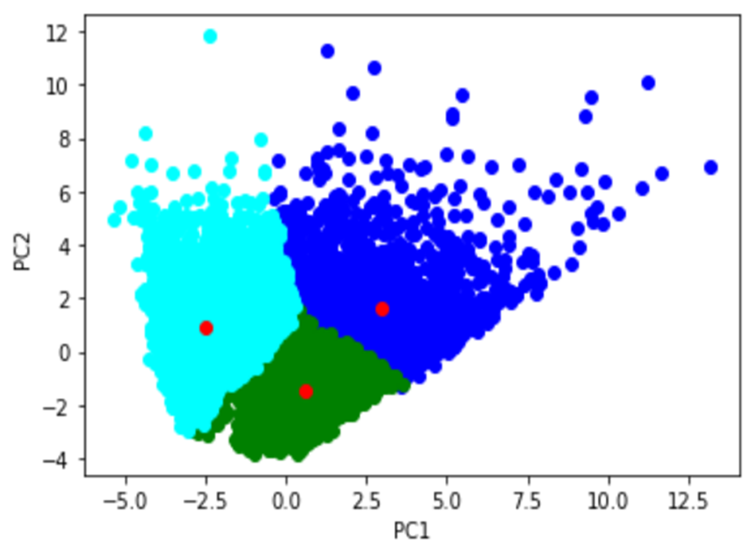
K-means Clustering

Slide 6

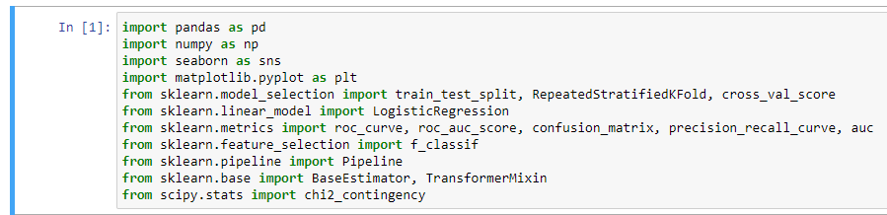
Libraries and modules included

Slide 7

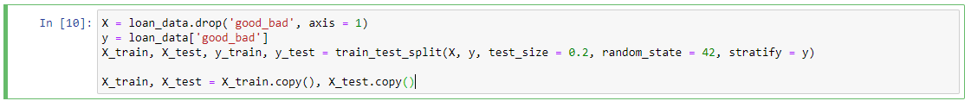
Train-test split
After identifying target variable as ‘Loan Status’, we split data 80/20 while keeping the distribution of bad loans in test set same as that in the pre-split dataset using train-test split
The train-test split procedure is used to estimate the performance of machine learning algorithms when they are used to make predictions on data not used to train the model.
The train-test split procedure is appropriate when you have a very large dataset, a costly model to train, or require a good estimate of model performance quickly.

Slide 8

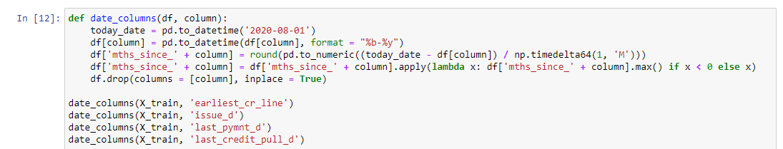
Converting non numerical data to numerical:
Since we have many columns eg.dates, months, whose data we cannot use directly in further algorithms, we convert the such data to fully numerical data by creating functions.
Below is a function to convert date columns to datetime format and create a new column as a difference between today and the respective date :

Slide 9

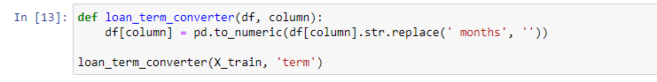
Similarly a function to convert ‘string’ type data in the column on ‘months’ to the numeric data with the following code:
We thereafter divide trained data into categorical and numerical subsets with the following code:
We now have our data divided into: categorical type and numerical type.
Now we apply
Chi-squared statistic for the categorical type data
Anova statistic for numerical type data

Slide 10

Chi-Square Test of Independence
The Chi-Square test of independence is used to determine if there is a significant relationship between two nominal (categorical) variables. The frequency of each category for one nominal variable is compared across the categories of the second nominal variable.
To begin we Chi Squared test, we firstly lay down the hypotheses:
Null hypothesis: this hypothesis assumes that there is no relation between the two variables.
Alternate hypothesis: this hypothesis assumes that there is a relation between the two variables.

Slide 11

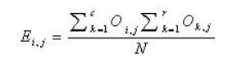
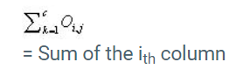
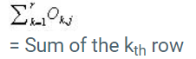
Calculating chi squared statistic:
First we have to calculate the expected value of the two nominal variables. We can calculate the expected value of the two nominal variables by using this formula:
Where, Ei,j = expected value
N = total numbers

Slide 12
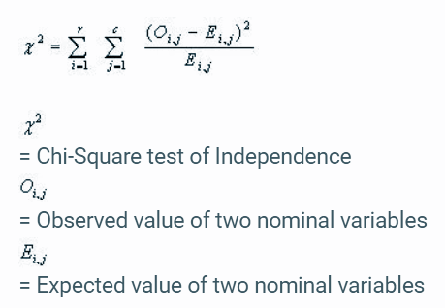
After calculating expected values, the chi squared statistic can be calculated as:
Chi-square = χ2 =
The degree of freedom can be calculated as
DF = (r-1)(c-1)
where, r = no. of rows,
c = no. of columns
The χ2 thus obtained is compared to a critical value which is determined by the level of significance (typically 0.05) and degrees of freedom. If the test statistic is lesser than the critical value, the null hypothesis is considered correct (the variables are non-related), else alternate hypothesis is correct.

Slide 13

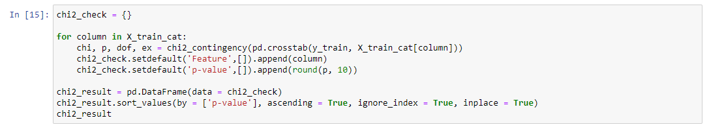
Code snippet for chi squared

Slide 14

ANOVA (Analysis of Variance) and F-test
Analysis of variance (ANOVA) can determine whether the means of three or more groups are different. ANOVA uses F-tests to statistically test the equality of means.
F-tests are named after its test statistic, F, which was named in honor of Sir Ronald Fisher. The F-statistic is simply a ratio of two variances.
F = variance between the sample means
Variation within samples

Slide 15
For example, if we have 4 samples, each having 5 readings as follows:
 | Category A | Category B | Category C | Category D
Reading 1 | a1 | b1 | c1 | d1
Reading 2 | a2 | b2 | c2 | d2
Reading 3 | a3 | b3 | c3 | d3
Reading 4 | a4 | b4 | c4 | d4
Reading 5 | a5 | b5 | c5 | d5
Mean | m1 | m2 | m3 | m4
Where, Z = variance between the set of means (m1,m2,m3,m4)
and , A = variance of all the Readings (a1,a2….d4,d5)
F = Z/A

Slide 16

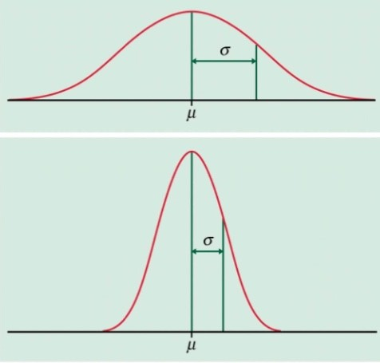
F = Z/A
The plot above is the nature of the graph which has more variance (relative to the lower one). It is more scattered around its mean (u). This sample will lead to a bigger ‘A’.
The plot below is the nature of the graph having lesser variance (relative to the upper one). It is more clustered around its mean (u). This sample will lead to smaller ‘A’.

Slide 17

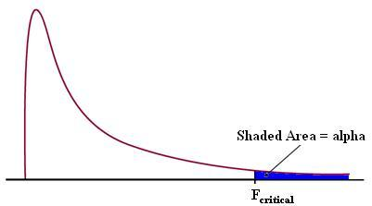
Rejection area
A critical value is obtained by plotting all the different F ratios for different degrees of freedom.
The area lying ahead the F_{critical} (shaded in blue) is called the rejection area. If the F value lies in the rejection area, we reject our null hypothesis that the variables are not related.

Slide 18
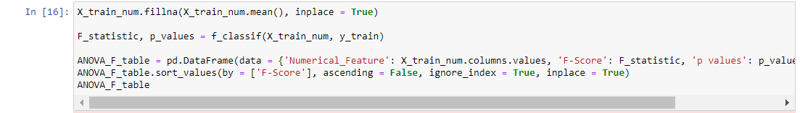
Code snippet for ANOVA
applied for each pair of applicable columns

Slide 19
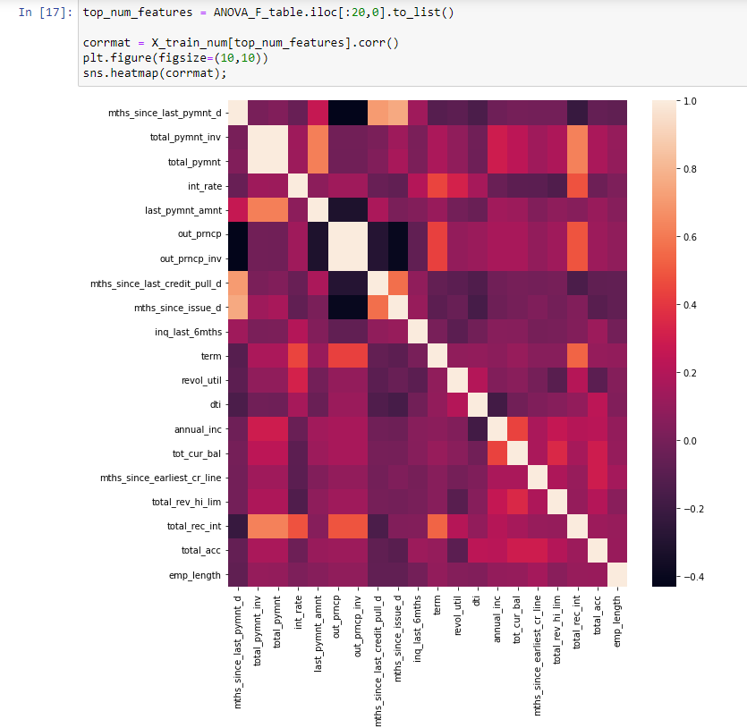
Heatmap of thus obtained relations
between columns

Slide 20
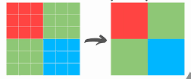
What is Binning of Data?
Binning is a way to group a number of more or less continuous values into a smaller number of "bins".
There is also an option to group categorical values into bins. This is useful when we have more categorical values in a column than you find necessary.
In simpler words, Data binning is a data pre-processing method used to minimize the effects of small observation errors. The original data values are divided into small intervals known as bins and then they are replaced by a general value calculated for that bin.

Slide 21

WOE (Weight of Evidence)
WOE measures the relative risk of an attribute of binning level. The value depends on whether the value of the target variable is a nonevent or an event.
It tells the predictive power of an independent variable in relation to the dependent variable. Since it evolved from credit scoring world, it is generally described as a measure of the separation of good and bad customers.

Slide 22
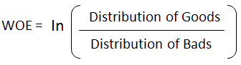
How to find WOE?
Distribution of Goods - % of Good Customers in a particular group Distribution of Bads - % of Bad Customers in a particular group ln - Natural Log
Following formula can be used for calculating WOE:

Slide 23


Inferences from WOE and its use
Positive WOE means Distribution of Goods > Distribution of Bads
Negative WOE means Distribution of Goods < Distribution of Bads.
Weight of Evidence (WOE) helps to transform a continuous independent variable into a set of groups or bins based on similarity of dependent variable distribution i.e. number of events and non-events.

Slide 24

How to use WOE?
For continuous independent variables : First, create bins (categories / groups) for a continuous independent variable and then combine categories with similar WOE values and replace categories with WOE values.
For categorical independent variables : Combine categories with similar WOE and then create new categories of an independent variable with continuous WOE values.
Note : We combine categories with similar WOE because the categories with similar WOE have almost same proportion of events and non-events.

Slide 25

Some rules for using WOE
Each bin should have at least 5% of the observations otherwise it would be insignificant.
Each bin should be non-zero for both non-events and events.
Similar groups should be aggregated.
The WOE should be monotonic, i.e. either growing or decreasing with the groupings.
Missing values are binned separately.

Slide 26
Information Value
Information value is one of the most useful technique to select important variables in a predictive model.
IV = ∑ (% of non-events - % of events) * WOE
Note that the term (percentage of events – the percentage of non-events) follows the same sign as WOE hence ensuring that the IV is always a positive number.

Slide 27
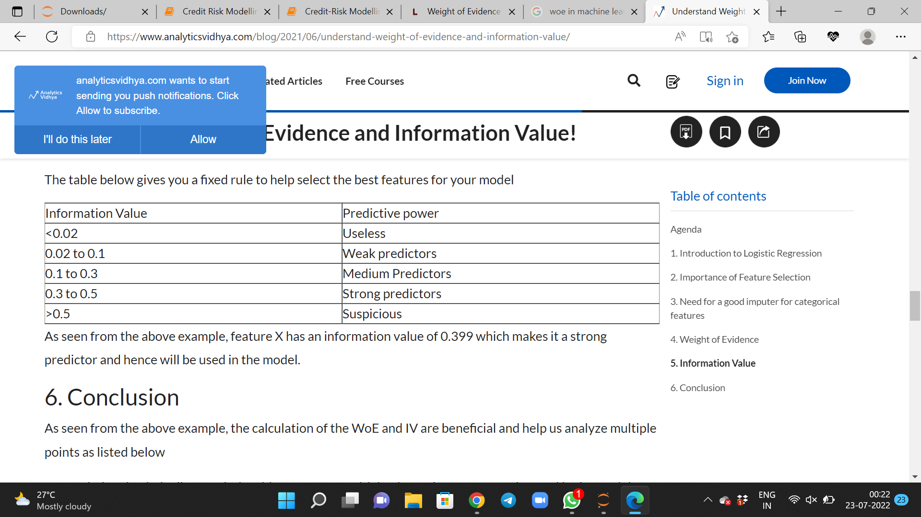
Inferences from IV values
The table below gives you a fixed rule to help select the best features for our model

Slide 28
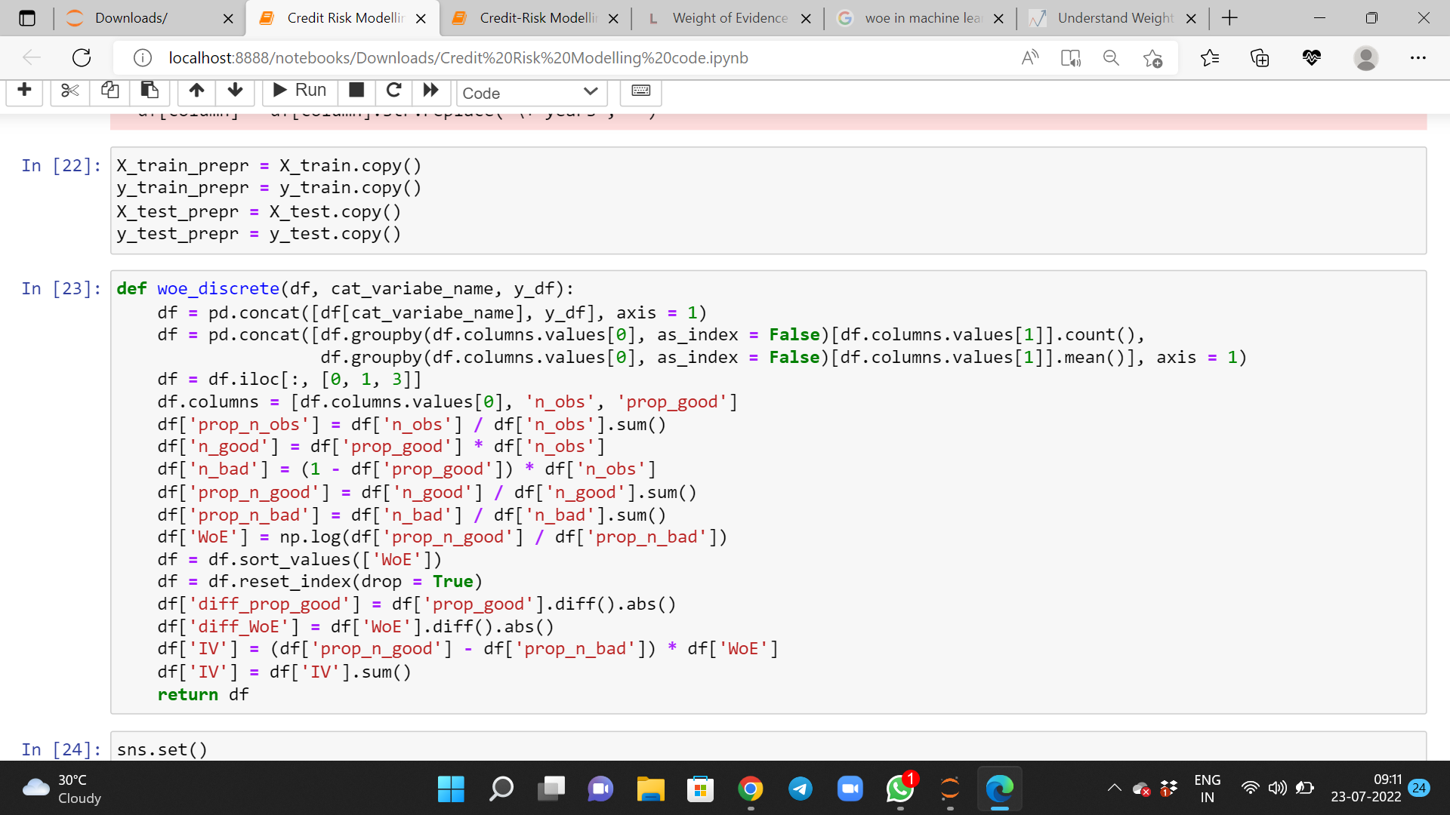
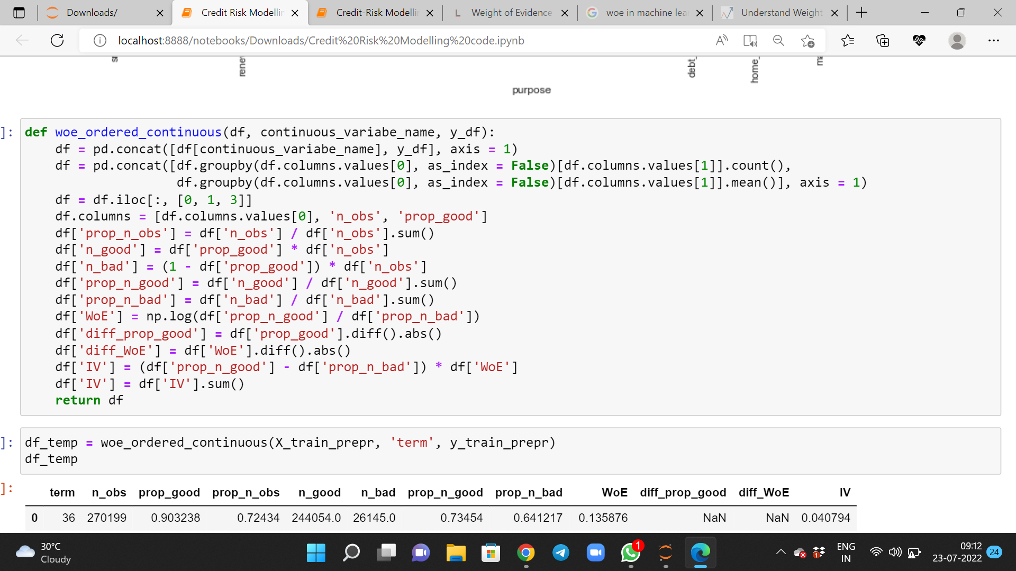
Understanding through Code

Slide 29
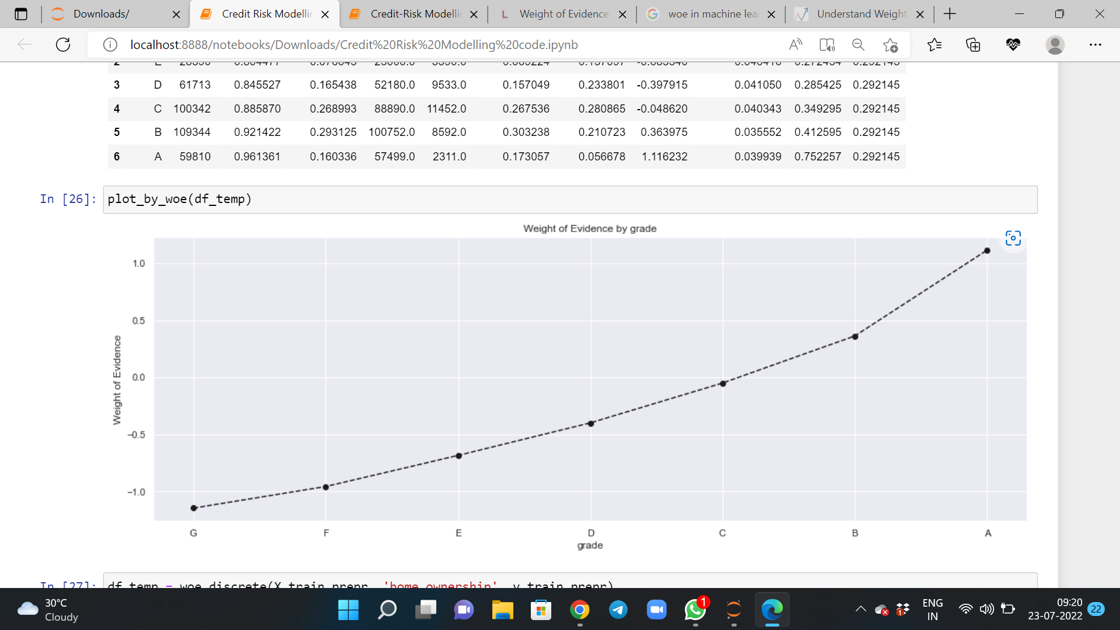
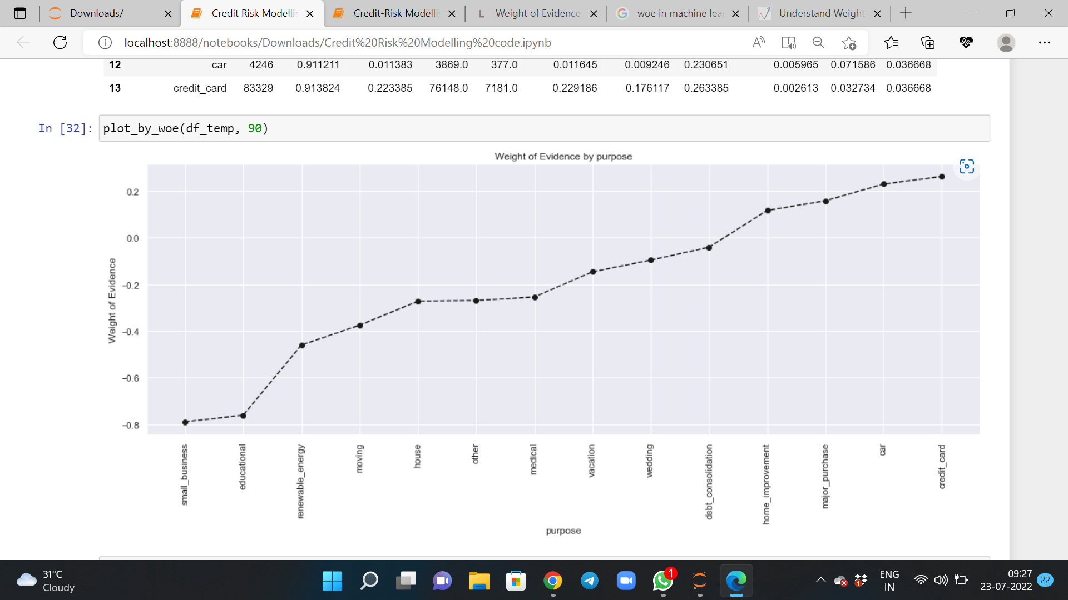
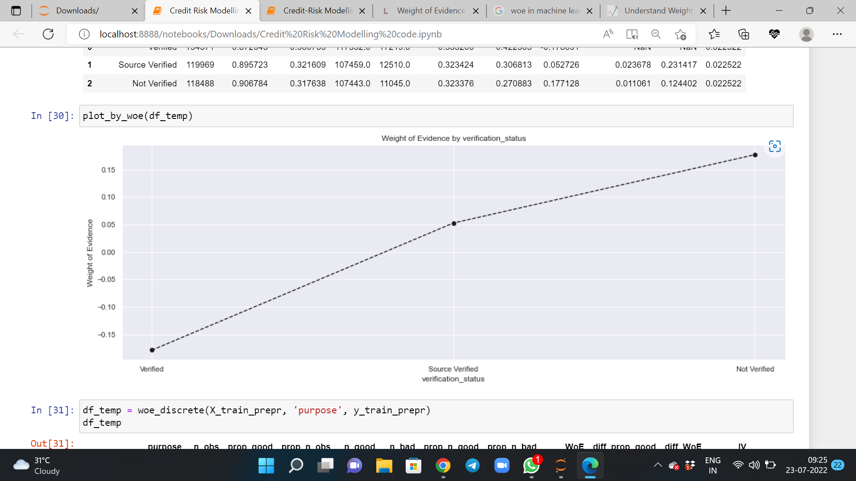
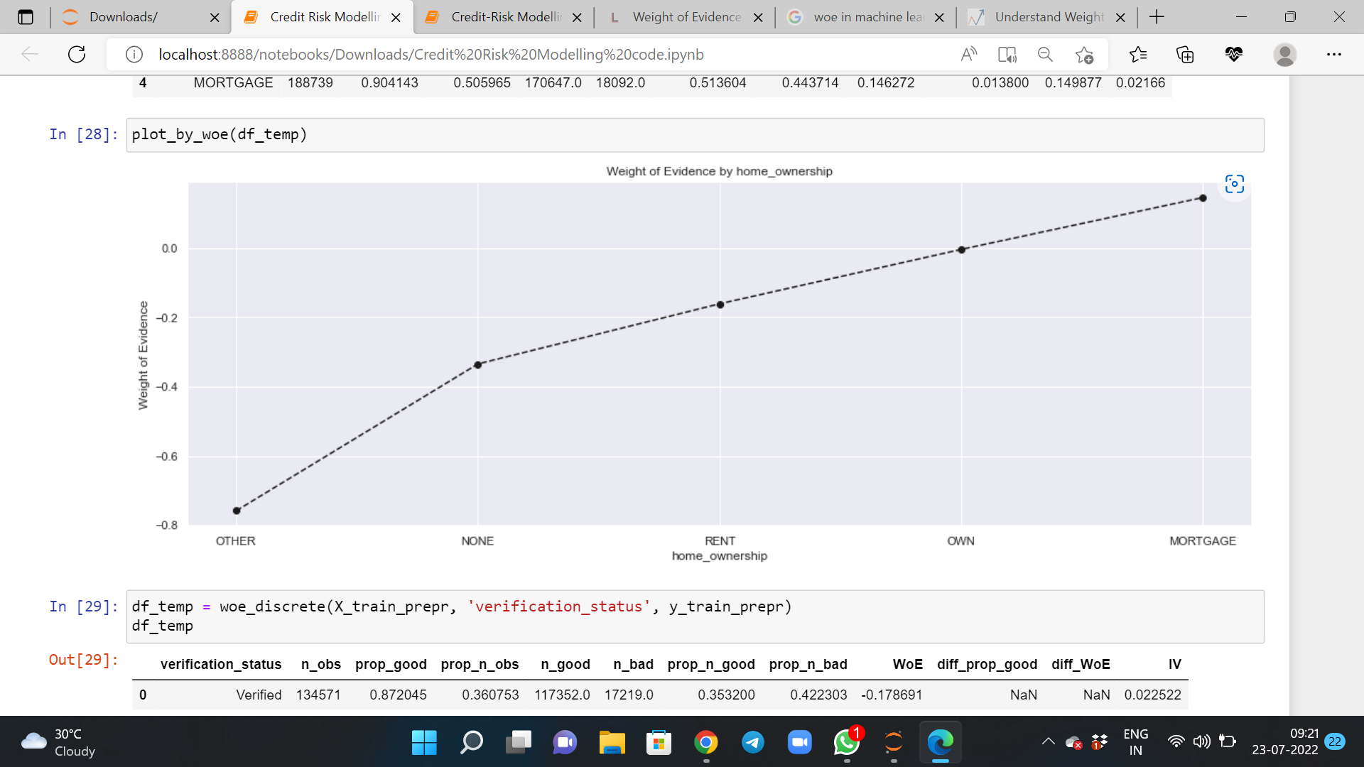
Graph Plot for WOE

Slide 30

Conclusion from WOE and IV
WOE can handle missing values as missing values can be binned separately.
WOE transformation helps us to build strict linear relationship with log odds. Otherwise it is not easy to accomplish linear relationship using other transformation methods such as log, square-root etc.
Thus we handled our dataset and binned it using WOE and IV for further processing of our credit risk management task.

Slide 31
Creating Custom Class
Now, we created a custom scikit-learn class to take care of all binning transformations on any given data set. This custom class will help us in performing k fold cross validation.
This custom class created new categorical dummy features based on the cut-off points that we manually identified based on the WOE plots and IV earlier.
Now we will use it as a part of a scikit-learn Pipeline.

Slide 32
The Probability of Default (PD) is the likelihood that a borrower will fail to pay back a debt.
Making A PD Model
Steps involved in a PD-Model :
STEP-1: Define a Modelling Pipeline
Step-2: Define Cross-Validation Criteria
Step-3:Get AUROC and GINI scores:

Slide 33
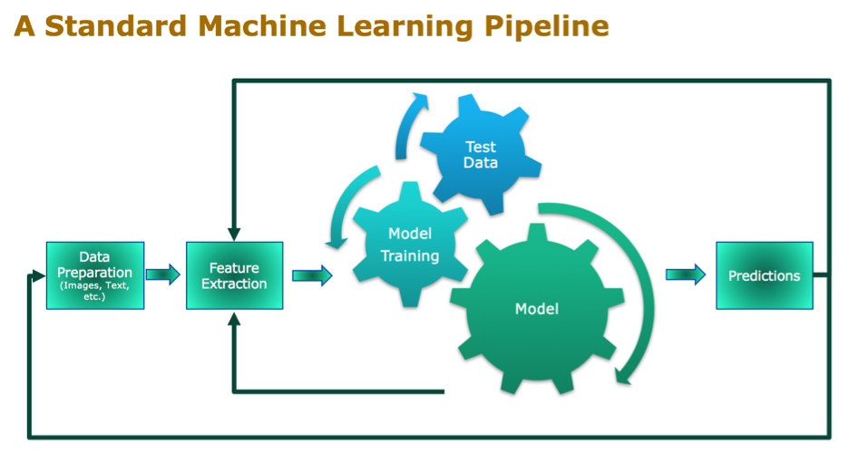
STEP-1: Define a Modelling Pipeline
Pipeline-Steps in a PD-model:
WOE-Binning.
Logistic Regression: - Logistic regression estimates the probability of an event occurring, such as default/no default, based on a given dataset of independent variables.

Slide 34
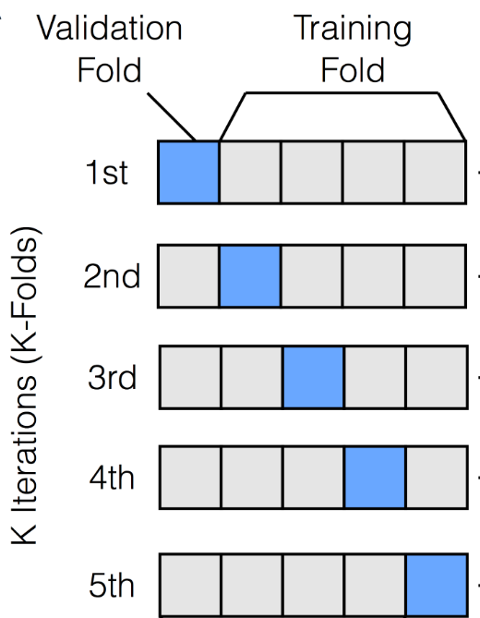
Step-2: Define Cross-Validation Criteria
The goal of cross-validation is to test the model's ability to predict new data that was not used in estimating it.
Here we use “Repeated-Stratified-K-fold” technique.
K-Fold Cross Validation:
Split the dataset into k groups
For each unique group, take the group as a hold out or test data set.
Take the remaining groups as a training data set
Fit a model on the training set and evaluate it on the test set.

Slide 35
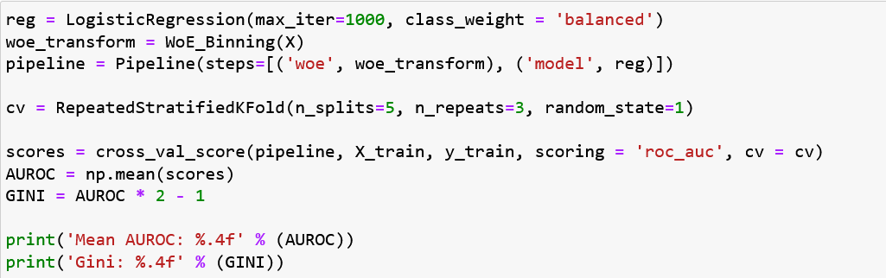
Code Snippet: (For Steps 1-3)

Slide 36
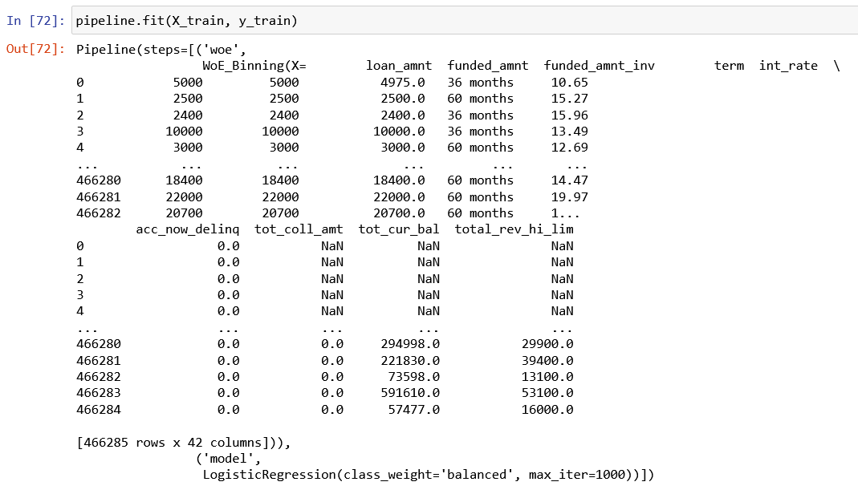

Slide 37
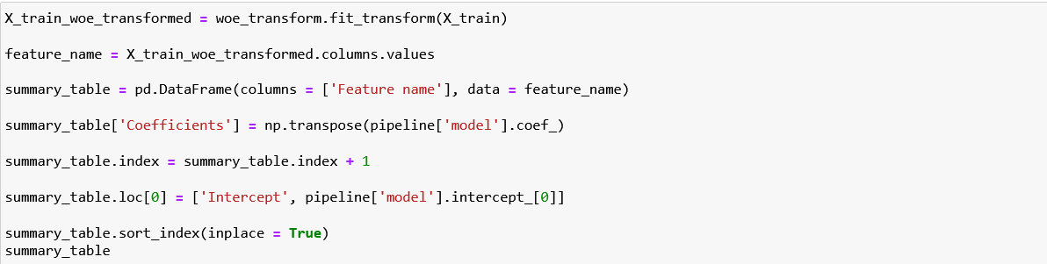
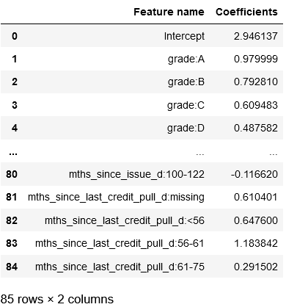
Apply WOE transform and Creating a Summary Table of the logistic Regression Model
Add a new column in the data frame, called 'Coefficients', with row values the transposed coefficients from the 'Logistic Regression' model

Slide 38
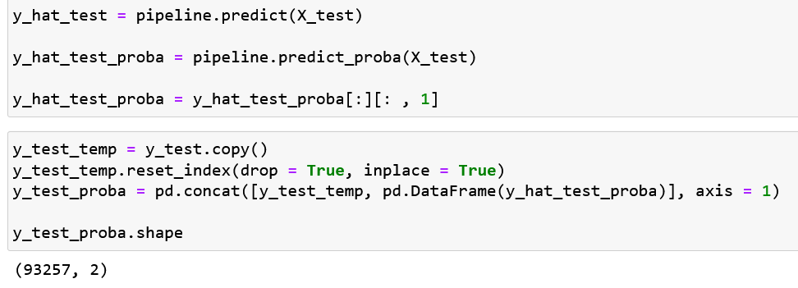
Predictions on our test-set
y_hat_test_proba contains the predicted probabilities.
y_tets_proba contains actual classes and predicted probabilities.

Slide 39
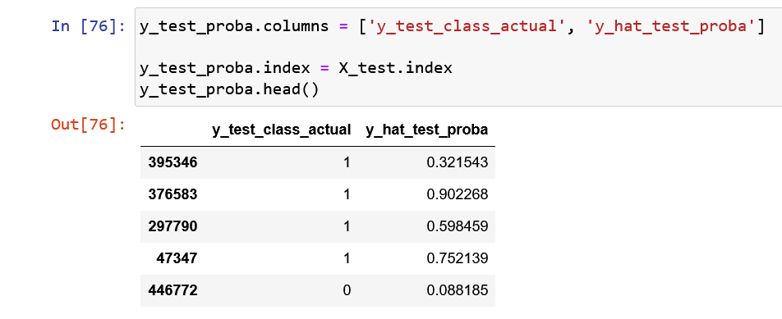
Modify y_test_proba and make its index equal to that of that of X_test

Slide 40

Threshold Value
The value is used to differentiate good with bad.
many machine learning algorithms are capable of predicting a probability or scoring of class membership, and this must be interpreted before it can be mapped to a crisp class label. This is achieved by using a threshold, such as 0.5, where all values equal or greater than the threshold are mapped to one class and all other values are mapped to another class.
In some cases, such as when using ROC Curves and Precision-Recall Curves, the best or optimal threshold for the classifier can be calculated directly. In other cases, it is possible to use a grid search to tune the threshold and locate the optimal value.

Slide 41
Confusion matrix
confusion matrix is defined as a technique to calculate the performance of classification. The confusion matrix is also used to predict or summarise the result of the classification problem.
The confusion matrix also predicted the number of correct and incorrect predictions of the classification model.

Slide 42

ROC CURVE
An ROC curve (receiver operating characteristic curve) is a graph showing the performance of a classification model at all classification thresholds. This curve plots two parameters:
True Positive Rate
False Positive Rate
True Positive Rate (TPR) is a synonym for recall and is therefore defined as follows:
TPR=TP/(TP+FN)
False Positive Rate (FPR) is defined as follows:
FPR=FP/(FP+TN)
An ROC curve plots TPR vs. FPR at different classification thresholds. Lowering the classification threshold classifies more items as positive, thus increasing both False Positives and True Positives.

Slide 43
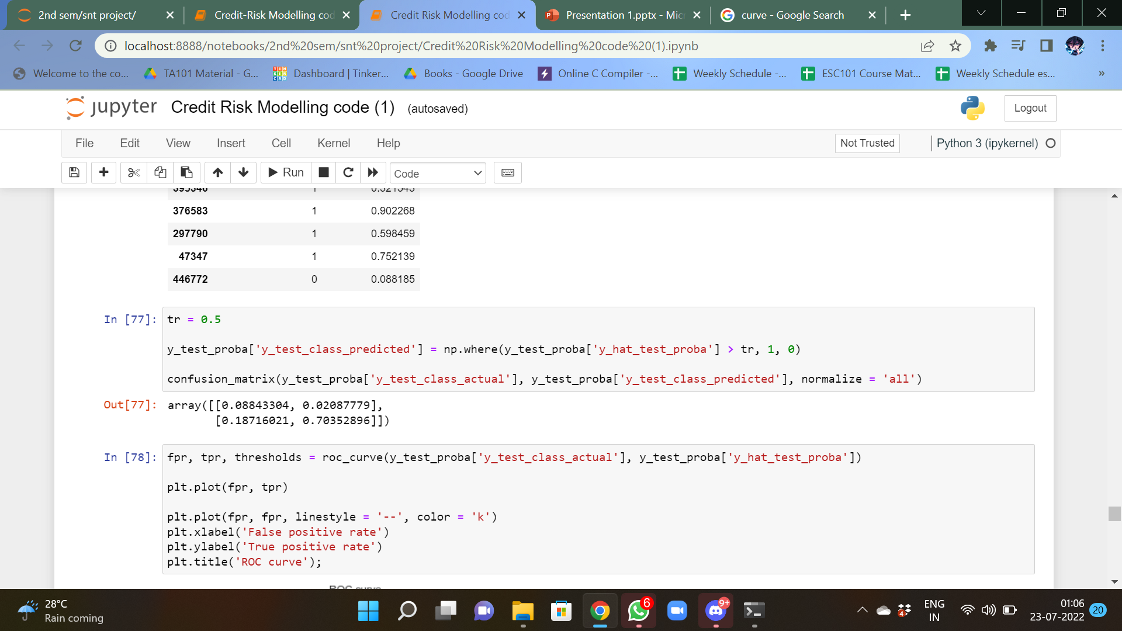
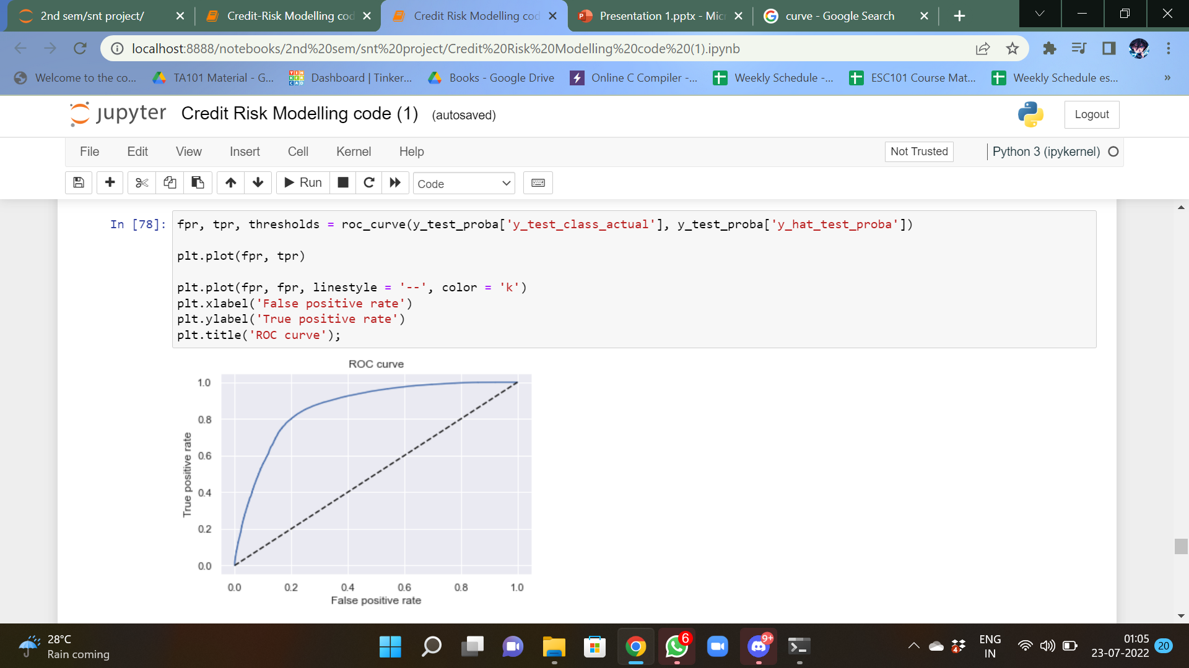
Code snippets :- 1)confusion matrix 2)Roc curve

Slide 44
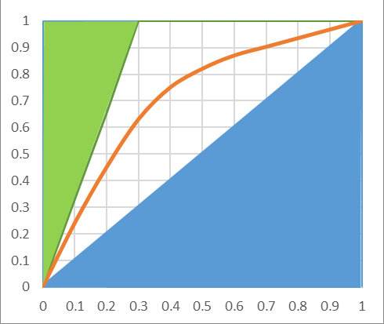
AUROC AND GINI COEFFICIENT
The area under the receiver operating characteristic (AUROC) is a performance metric that you can use to evaluate classification models.
The AUROC is calculated as the area under the ROC curve. A ROC curve shows the trade-off between true positive rate (TPR) and false positive rate (FPR) across different decision thresholds. For a review of TPRs, FPRs, and decision thresholds
The x-axis of a ROC curve is the false positive rate, and the y-axis of a ROC curve is the true positive rate.
Gini COEFFICIENT = (AUROC x 2) -1

Slide 45

PR CURVE
The precision-recall curve shows the trade off between precision and recall for different threshold. A high area under the curve represents both high recall and high precision, where high precision relates to a low false positive rate, and high recall relates to a low false negative rate. High scores for both show that the classifier is returning accurate results (high precision), as well as returning a majority of all positive results (high recall).
Precision (P) is defined as the number of true positives (Tp) over the number of true positives plus the number of false positives (Fp).
P=Tp/(Tp+Fp)
Recall (R) is defined as the number of true positives (Tp) over the number of true positives plus the number of false negatives (Fn).
R=Tp/(Tp+Fn)

Slide 46
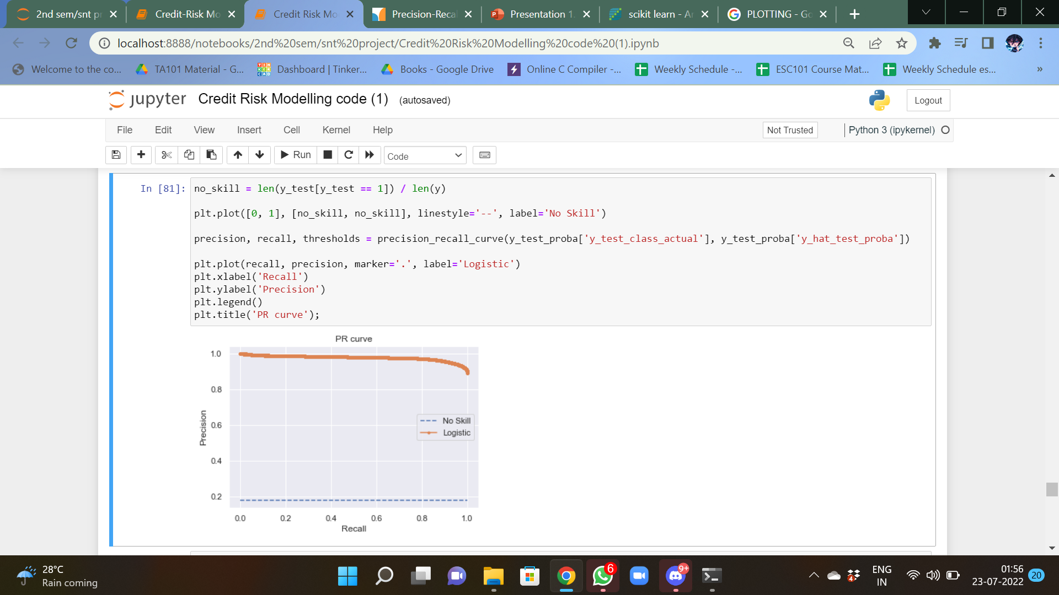
plotTING the no skill precision-recall curve

Slide 47

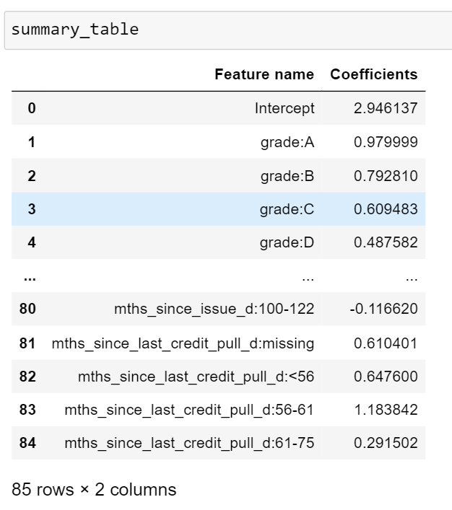
Summary Table
Printing the summary table followed by CREATING A NEW DATAFRAME WITH ONE COLUMN
And its values are the values from the 'reference_categories' list along with corresponding coefficients in another column

Slide 48
concatenation of DataFrame
concatenation can be used to combine subsets of a DataFrame, or even data from different files.
concat() function does all of the heavy lifting of performing concatenation operations along an axis while performing optional set logic of the indexes on the other axes.

Slide 49
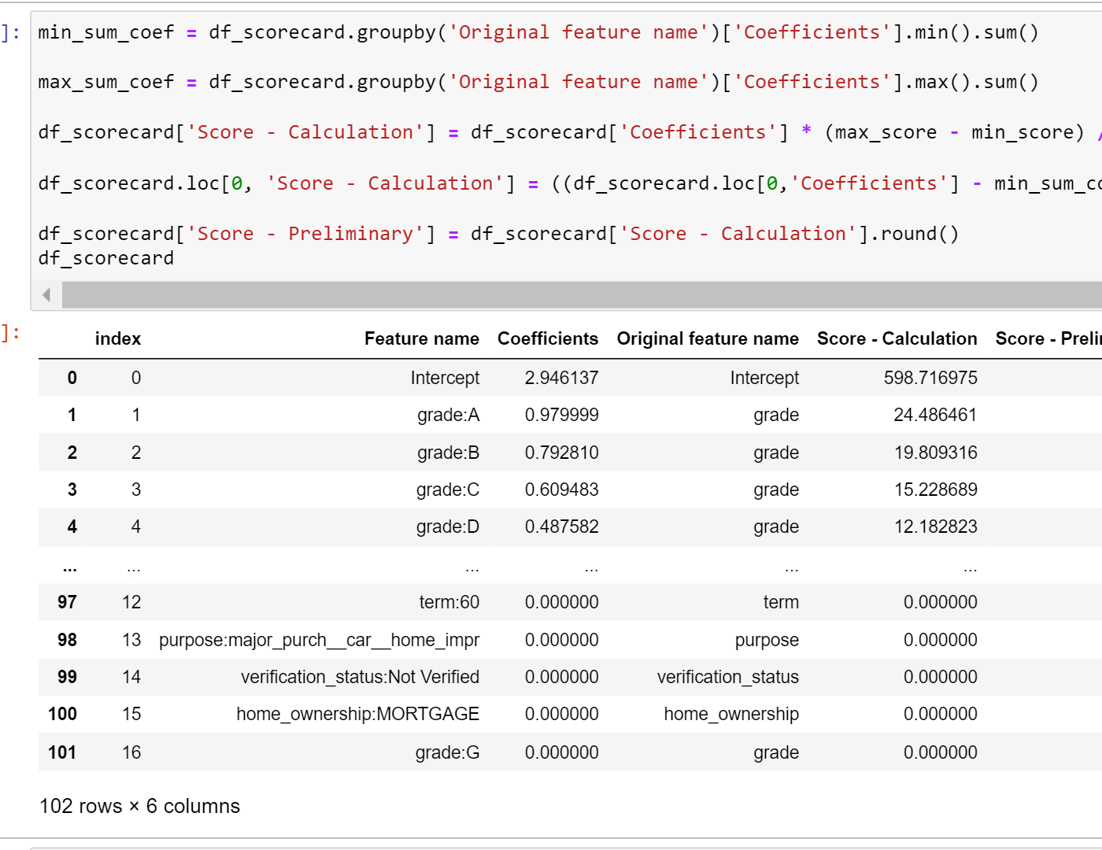
calculating the sum of the minimum and maximum coefficients of each category
After concatenating the DataFrame and setting up the minimum and maximum threshold , we calculated the sum of minimum and maximum coefficients .
created a new columns that has the imputed calculated Score based on the multiplication of the coefficient by the ratio of the differences between maximum & minimum score and maximum & minimum sum of coefficients

Slide 50
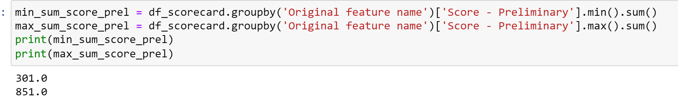
Observation
checking the min and max possible scores of our scorecard.
both our min and max scores are out by +1. we need to manually adjust this to decide which one we'll evaluate based on the rounding differences of the minimum category within each Original Feature Name
we can get by deducting 1 from the Intercept.

Slide 51

CREDIT SCORE
SIGNIFICANCE AND CALCULATION

Slide 52
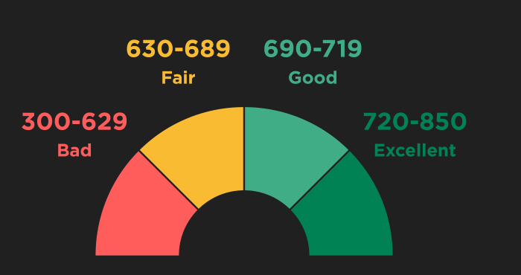
Credit Score
A credit score is a number between 300 and 850 that depicts a consumer's creditworthiness. The higher the score, the better a borrower looks to potential lenders. A credit score is based on credit history: number of open accounts, total levels of debt, and repayment history, and other factors
Lenders use credit scores to evaluate the probability that an individual will repay loans in a timely manner
People with credit scores below 640, for example, are generally considered to be subprime borrowers conversely, a credit score of 700 or above is generally considered good

Slide 53
Calculating Credit Score
create a transformed test set through WoE Binning custom class
insert an Intercept column in its beginning to align with the number of rows in scorecard
The number of columns in test set is lesser than that of rows in scorecard due to reference categories
The reference categories will always be scored as 0 based on the scorecard, so adding these categories to the end of test set with 0 value
Dot multiplication between test set and scorecard

Slide 54
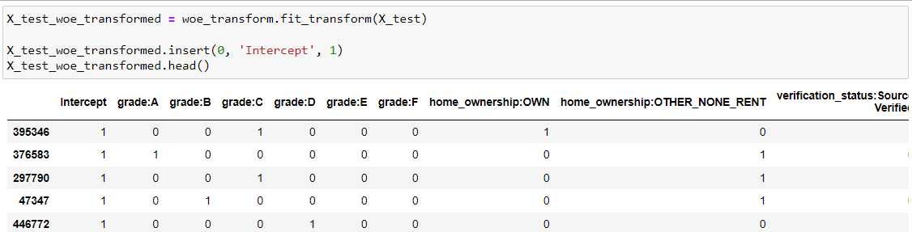
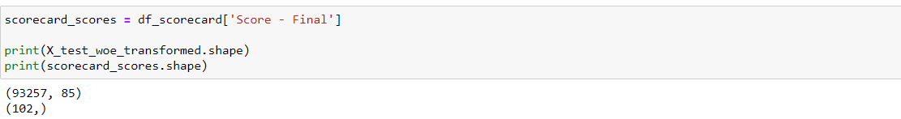
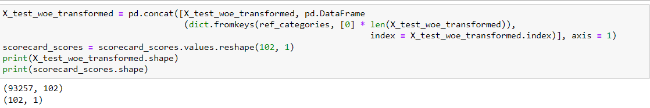
Understanding through Code

Slide 55
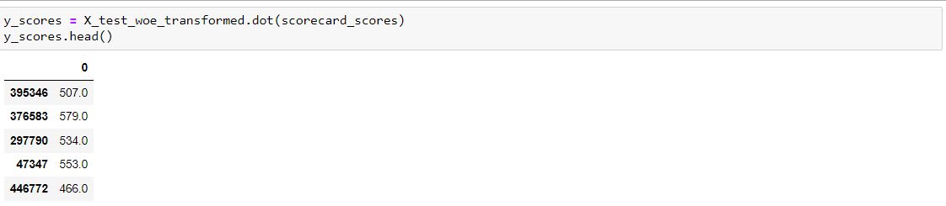
Understanding through Code

Slide 56
Youden’s J Stastistics
Youden's J statistic (also called Youden's index) is a single statistic that captures the performance of a dichotomous diagnostic test. Informed Ness is its generalization to the multiclass case and estimates the probability of an informed decision.
Its value ranges from 0 through 1 (inclusive), and has a zero value when a diagnostic test gives the same proportion of positive results for groups with and without the disease, i.e., the test is useless
A value of 1 indicates that there are no false positives or false negatives, i.e., the test is perfect

Slide 57
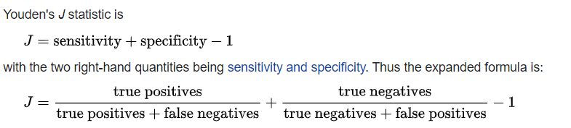
Calculation and usage
Youden's index is often used in conjunction with receiver operating characteristic(ROC) analysis. The index is defined for all points of an ROC curve, and the maximum value of the index may be used as a criterion for selecting the optimum cut-off point when a diagnostic test gives a numeric rather than a dichotomous result.
The index is represented graphically as the height above the chance line, and it is also equivalent to the area under the curve subtended by a single operating point.

Slide 58
Setting loan approval cutoffs
Calculate Youden's J-Statistic to identify the best threshold
Update the threshold value, create a new column for the predicted class based on predicted probabilities and threshold and create the confusion matrix
Create a new DF comprising of the thresholds from the ROC output and calculate Score corresponding to each threshold
Create a helper function ‘n_approved’
Calculate number of approved and rejected applications for each threshold using n_approved
Check at the approval and rejection rates at our ideal threshold
Compare the above rates with the case of the default 0.5 threshold

Slide 59
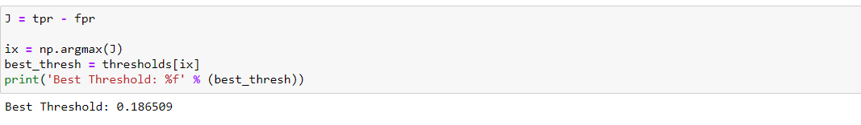
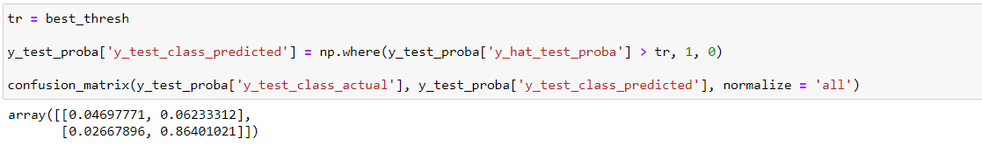
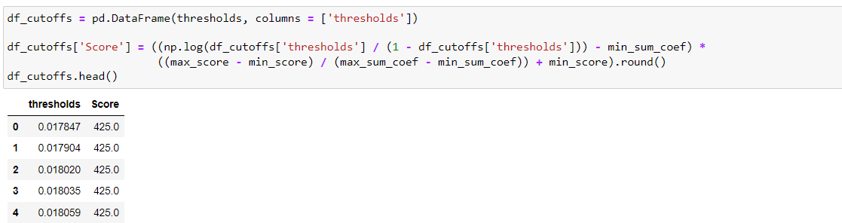
Code Snippets

Slide 60
‘n_approved’ helper function
KEY FEATURES
Assigns a value of 1 if a predicted probability is greater than the parameter p which is a threshold and a value of 0 if it is not
Then it sums the column.
for given any percentage values the function will return the number of rows with estimated probabilities greater than the threshold

Slide 61


Code Snippets

Slide 62

THANK YOU
Hope you liked the work

